Slide 1
Financial Awareness on
Investments and Trading
Stock Markets
CAPITAL MARKETS -BSE/NSE India
Satish CFA
Note :Stock Markets are Subject to Capital Markets ,Corporate Finance ,Investment Banking ,Portfolio Management & Risk Management

Slide 2
Course Content
Equity Investments and Trading
Long Term Investment
Short Term Investments
Derivatives Trading –Options
Fixed income investments –Bonds
Portfolio Management – Mutual Funds and ETF’s
Forex Trading
Money Markets

Slide 3
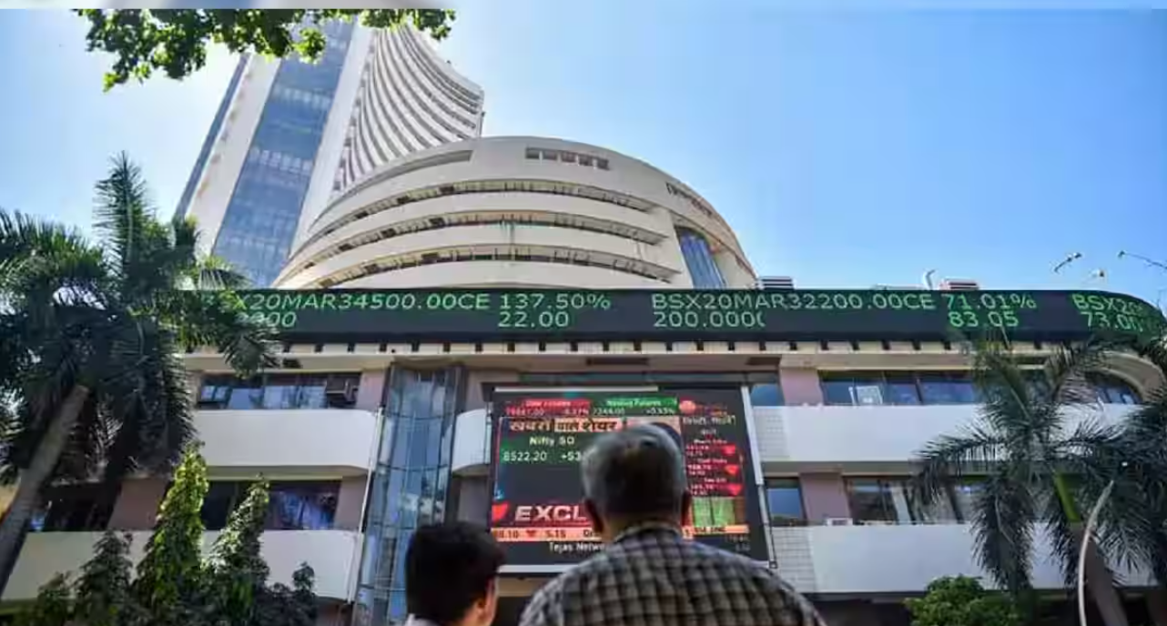
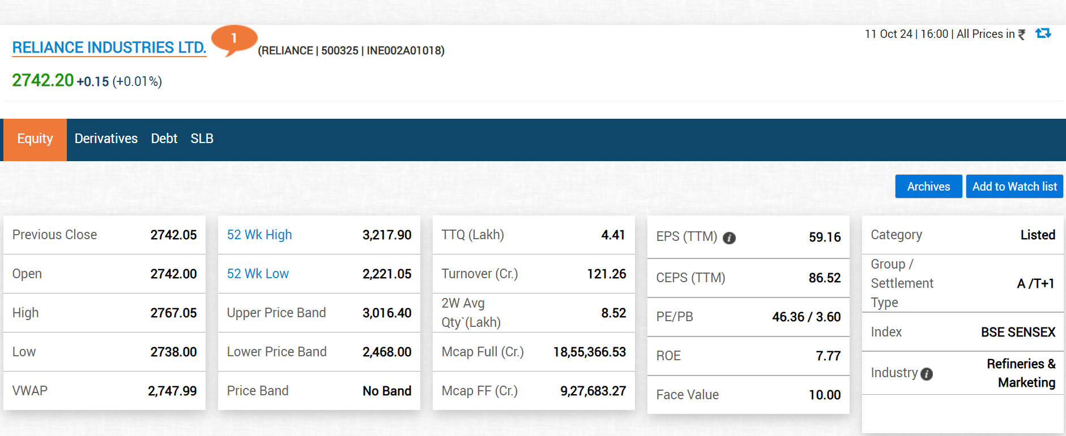
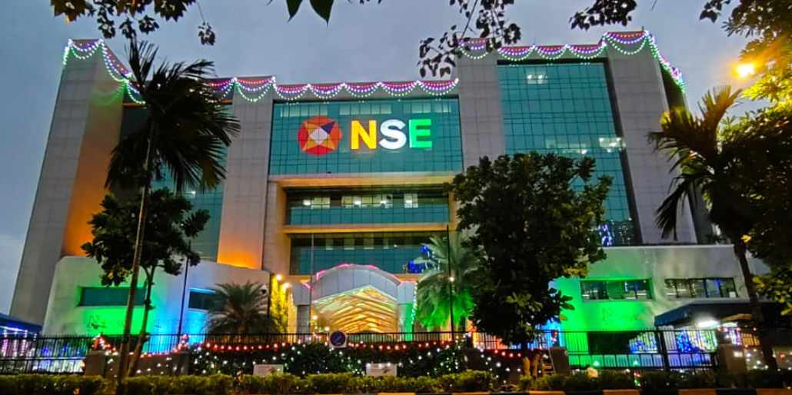
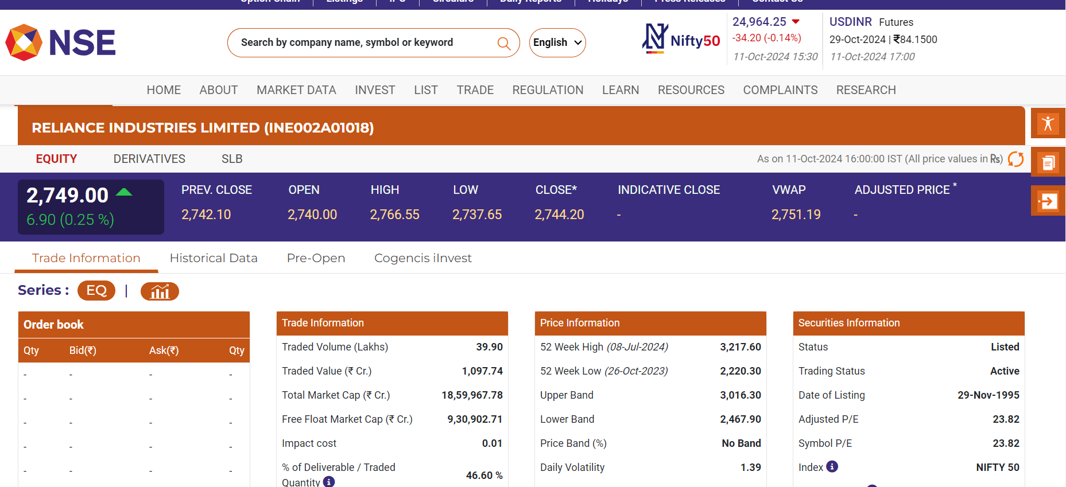
BSE & NSE –Relevant Functionalities

Slide 4
Long Term Investing : Equity Investments
Equity Pricing
DCF -Valuation
Financial Statements analysis
Monetary (RBI)& Government Polices
Tax Impact
EIC Framework
Qualitative –Factors
Fundamental Analysis & Ratios
Equity –Long-term Investing
Identification of Multi Bagger Stocks
Value and Growth Stocks, Dividend Income
Business and Investment cycles
Credit Rating
Risk Factors –Market Risk ,Credit risk, Interest rate Risk(Banks)
Fundamental Analysis & Financial Ratios
Market cycles ,Business cycles
Power of Compounding ,Time Value of Money
Rule of 72
Analyse –Bhav copy etc
Investment Cycles –Impact from Budget ,Tax polices , RBI ,Fin results, AGM ,Board Meetings ,Dividend etc
Technical Analysis : Trend Analysis/Pattern –
Historical Trends , How to view Long term ,Short term Patterns
VWAP , Moving averages-DMA,EMA ,RSI , Resistance and Supports-PIVOT based tools , Fibonacci ,Bollinger bands ,Fin results
Analysis from Trading View and Screeners

Slide 5
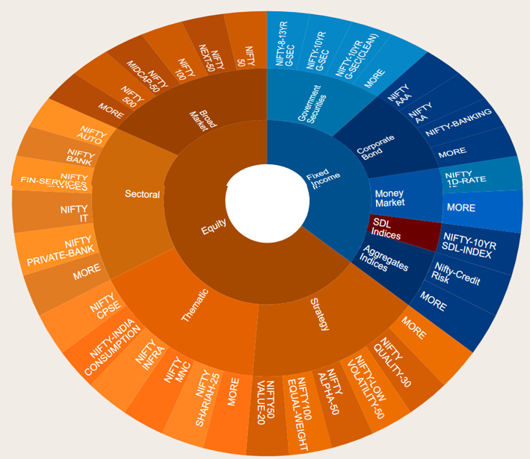
Portfolio Management -Indexing Long Term Investing :-Mutual Funds & ETF’s

Slide 6
Portfolio Management -Indexing Long Term Investing :-Mutual Funds & ETF’s
About Mutual Funds : Please save the Path
https://www.mutualfundssahihai.com/en

Slide 7
Portfolio Management Long Term Investing :-Mutual Funds & ETF’s
Mutual Funds
Behind
Types of Mutual Funds –Equity ,Debt ,Liquid Funds etc
Investments Goals –Long term ,Short term & Medium Term
Portfolio Diversification& Rebalancing-Portfolio creation
Tax Advantage
Indexation Benefit & Sector Allocation-From Indices
NFO’s-New Fund offerings
Mutual Funds Investing
NAV
CAGR
Open and Close Ended
Credit Rating & Risk Factors-Market risk
Evaluation of Fund Mgr capability measures
Return & Risk Measures-
Exchange Traded Funds –ETF’s
Investing in ETF’s
Differences and Advantage of Investing in ETF’s vs Mutual Funds

Slide 8
Long Term Investing: Bonds/ Fixed Income Investments
Bond Basics
Concepts on Treasury Yields/Government Bonds
Risk and Return from Fixed income instruments
Investments in Bonds
Corporate Bonds –Investments
Sovereign Gold Yield Bonds

Slide 9
Short Term Investing : Equity Investments & Money Markets-Investments
Equity –Short-term Investing
Corportate –Actions
Financial Results ,IPO’s
Bulk and Block Deals
Buying/Sellers Potential of Insttitutional investors-FII/DII’s/QIB’s
AGM/Board Meetings
Fundamental Analysis & Financial Ratios
Money Markets –Investing –HNI’s /Corporate Clients-More than 1- 5Lakh
GOI-Government dated Securities
CP’s
CD’s
T-Bills
Technical Analysis
VWAP ,Volume Profile analysis
Moving averages ,RSI , Resistance and Supports , Fibonacci ,Bollinger bands
Trend Analysis/Pattern –Short term Patterns

Slide 10
Forex Trading and Investments(Wealth management)
Forex –FX–Pricing Functionalities
Currency Pairs &Base Quote /Direct /Indirect Quotes
FX vs Events
Economic Events vs Fiscal Policies& Geo Political Affects -Like Inflation etc,Exports and Imports
FX vs Risks –Market risk ,Exchnage Risk ,Country Risk etc
Bid /Ask Spread
Currency Triangulation & Cross Currency & Arbitration
FX-Markets
FX-Options
FX-Spot ,Forwards
FX-Futures
Forex –FX Trading
Technical Analysis –Complete
Dow Theory & Sentimental Analysis
Price Action Patterns
Indicators –Trend /Volume/Momentum /Volatility
FX Order management /Limit mgmt./
FX-Trade Systems & Importance of Dollar Index –DXY and Crude

Slide 11
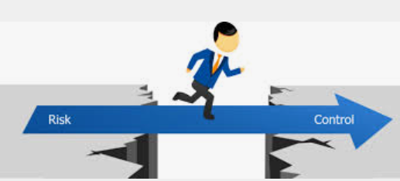
Options : Basic Objective -Capital Protection
Financial Institutions ,Banks ,Hedge Funds Etc
Retail Traders

Slide 12
Options Trading and Investments:
Option Pricing –Black Scholes model
Options & Futures
VIX –Volatility
Option Strategies –Hedging Techniques
Indexation –Impact from Events
Option Chain analysis
Greeks
Options Trading-Intraday and Long Term /Months
Index Derivatives –and Equity Derivatives
Option Chain Analysis ITM,ATM,OTM–More Profitable& Greeks
Technical Analysis Tools –EMA ,MACD ,Orderflow etc
FII/DII /open Interest /PCR/AD Ratio etc .
Events-Economic /Monetary /Financia evens lmpact –During the Day
Option Strategies /Hedging Techniques-Buy Side and Sell Side
Managing Portfolio through Investing in Options –AUM & BANKS /Institutions
----AUM’s Manage portfolio through investing on Long term options either Equity Derivatives and Index Derivatives with selection of Hedging techniques
----Market Risk (Greeks And VAR) Plays the key role
Option Analysis /Analytics –
Explain through Excel
Opstra/Sensibul /Stock Mock tools etc

Slide 13
Options :Hedging Techniques
Bullish Strategies
Long call Butterfly
Bull call Spread
Bull Put Butterfly
Long call and Short Put-Naked Positions
Bearish Strategies
Long Put Butterfly
Bear call Spread
Bear Put Spread
Long Put and Short Call
Neutral Strategies :-Non Directional
Short Side : Straddle & Strangle
Long Side : Straddle & Strangle
Short Put Butterfly and Short call Butterfly
Others :
IRON Butterfly / Short IRON Fly : Secured Profit & Protect the gain from Similar view of Short Straddle
IRON Condor /Short Iron Condor : Protect the gain from Similar view of Short Strangle

Slide 14
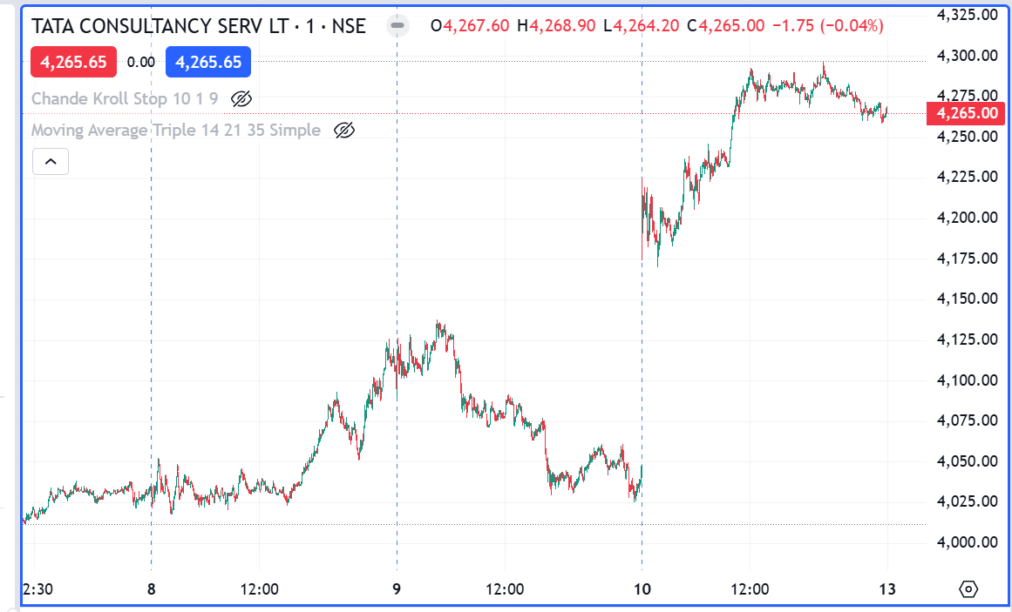
Hedging On Equity /Stock Options -Timing of Hedging
Financial Results
Mergers and Acquisitons
Getting Projects /New Announcements
Govt Intiates on Particular Sector
Currency appreciates/Depreciation –Impact on IT

Slide 15
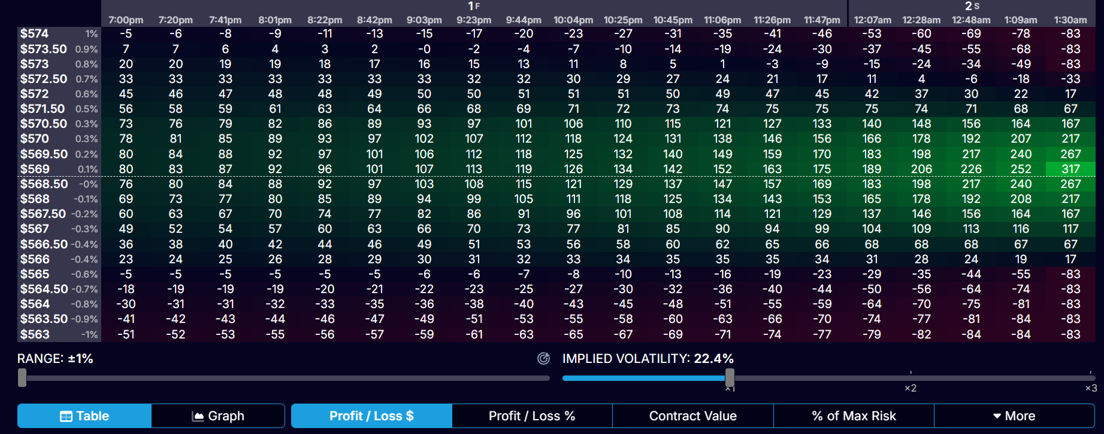
Options Strategies: Pay off Analysis

Slide 16
Retirement Planning /Financial Planning
Investing in Mutual Funds (Advantage from tax based policy instruments)
Investment in Debt and Equity oriented Funds
Investment –Insuarance coverage with Growth funds
Government schemes/Postal deposits
Investment in Long term –Equity

Slide 17
Coverage of Financial markets
Indian Markets
Sensex /Nifty 50
Bank Nifty
Fin Nifty
Gold
MCX
Forex
Analyze Impact from
Economies (RBI,US FED , Europe and Asian Markets ,union Budget etc)
Market events and Financial Events
Crude
Dollar Index (DXY )
US /Europe/Asian Markets
FII’s /DII’s etc

Slide 18
Technical Analysis & Data Analysis
Technical Analysis :
Candle sticks & Bar Charts and Line charts : Price Action from Green and Red Candle
Support and Resistance ,CPR , Pivot Points ,Break out analysis
VWAP –
Moving averages –DMA ,EMA ,MACD and RSI,Bollinger Bands
Super Trend and Fibonacci Retracement
Volume Analysis ,Open interest
Order Flow Analysis
Theories –of Identification of Long term Trends
DOW theory
Elliot wave Theory
Data Analysis
NSE Data
Data Analysis based on Python (API’s and Pandas)
Yahoo Finance
Trading view Data or other screeners etc
Company websites (Sources of Qualitative and Quantative data)

Slide 19
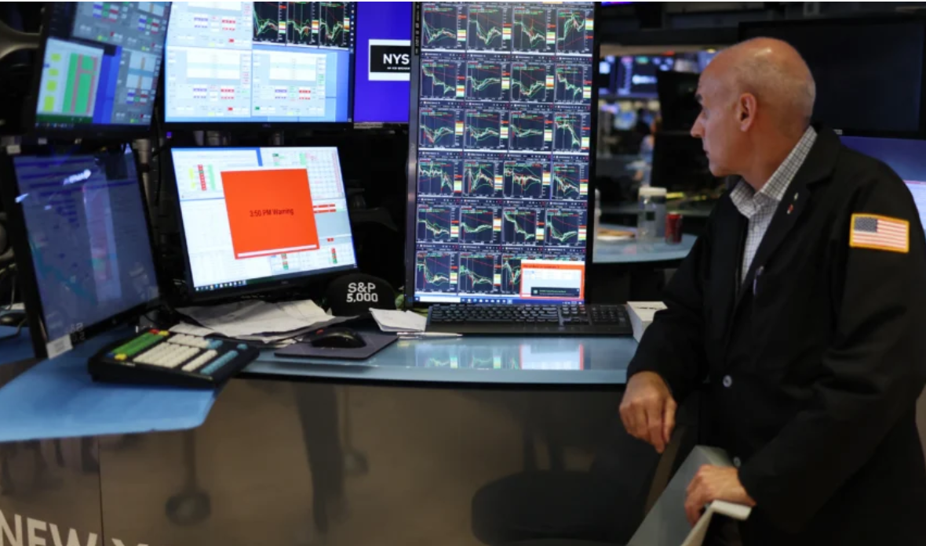
Operational Aspects (Handling Loss control) for Intraday Traders
Setting/Trading Objective Parameters: Target/Limit/Stop Loss etc.
Risk Management/Trade Psychology : Risk and Return /Risk vs Reward
Trading Behavior Functionalities & Risk Appetite of Individual :
The Person should have subjective , Highly Matured (handle any financial/Individual crisis mgmt) and Practical manner.
Practice the Hedge management techniques before trading.

Slide 20
Additional Topics –If Required
Equity Reasearch –DCF valuation
Treasury Products –More Specfic to Equity and Bonds & Futures and Options
BASEL –Guidelines vs Captial markets Profitability :
Capital adequacy ,Market risk ,Credit risk (Credit rating vs Investment),Liquidity ,Operational Risk etc.
Portfolio Management –
Investment Return and Risk Measures (Treynor's ratio ,Sharpe ratio, Jensen alpha) ,Active and Passive investments
SML vs CAPM (Investor expects more than CAPM)
Sector Specific – Investment Factors and Its Risk

Slide 21
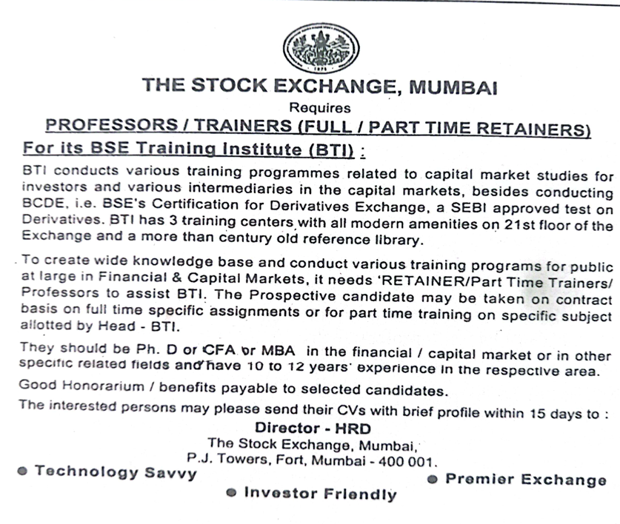
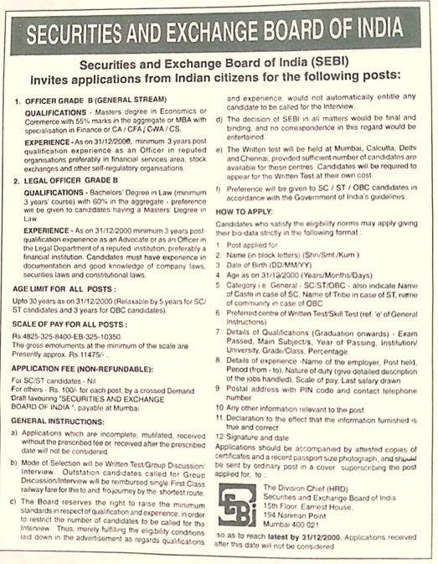
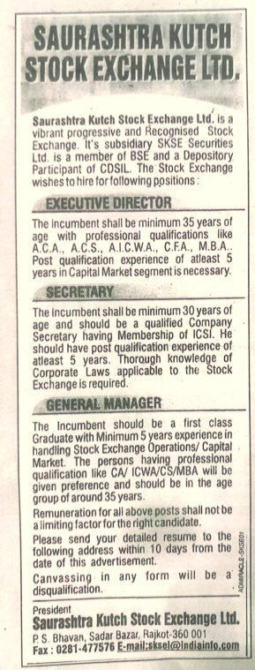
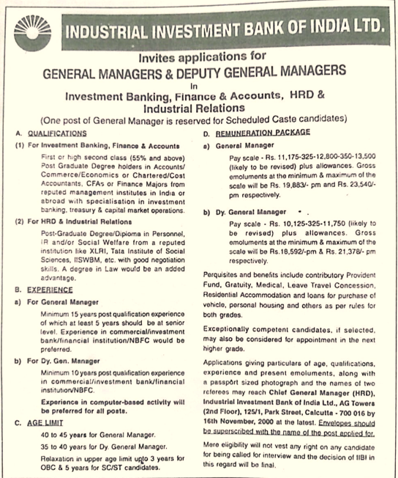
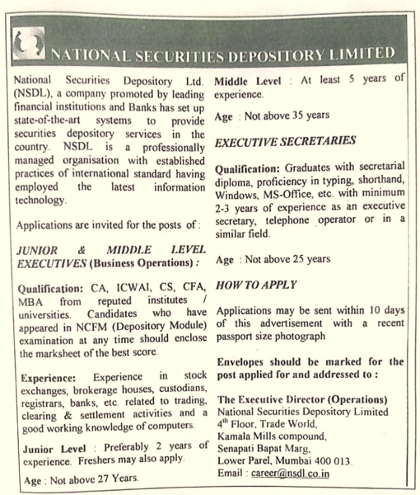
CFA Recognition –Since 1996 onwards Recongnized by: Stock Exchanges-BSE,Regulatories- SEBI ,NSDL & Institutions

Slide 22
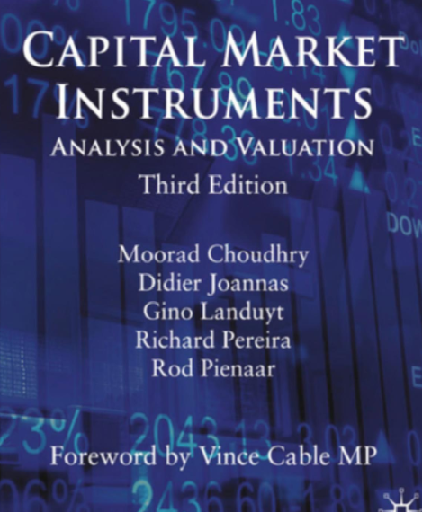
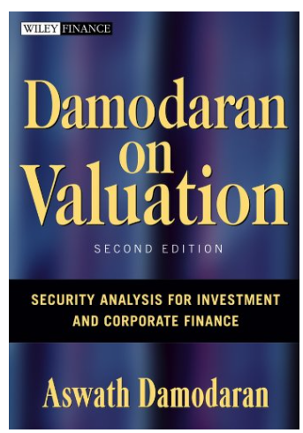
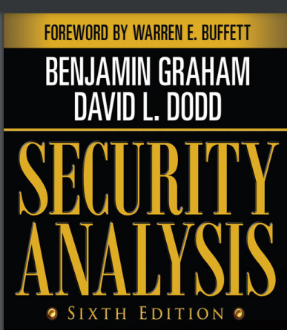
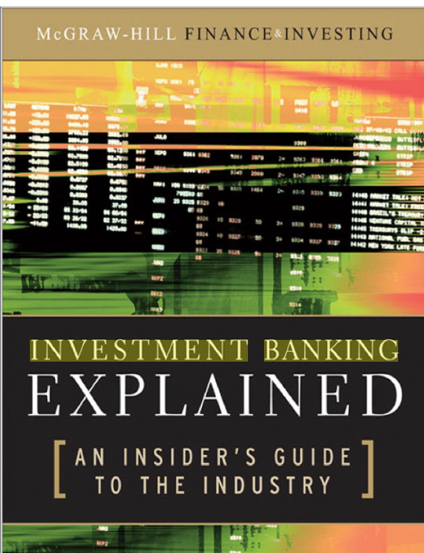
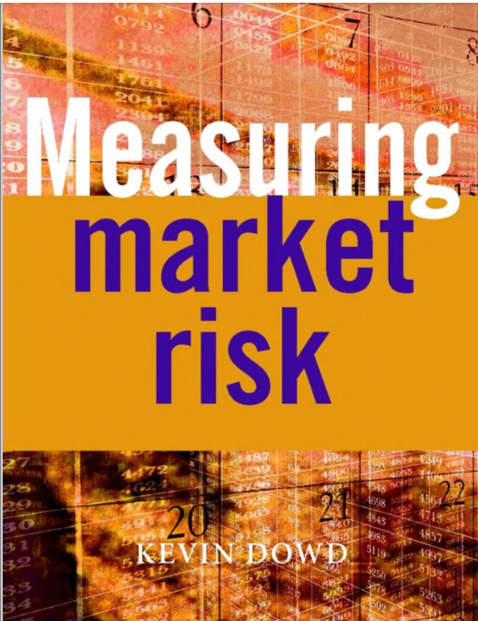
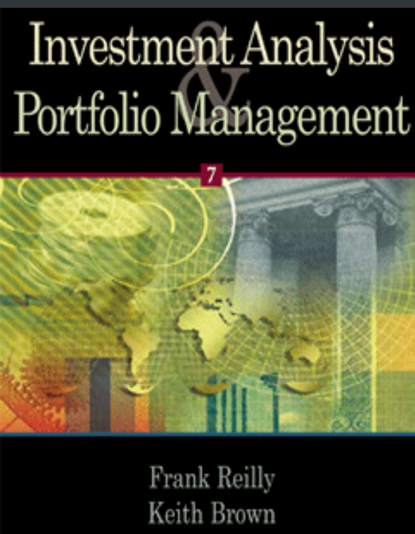
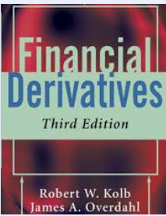
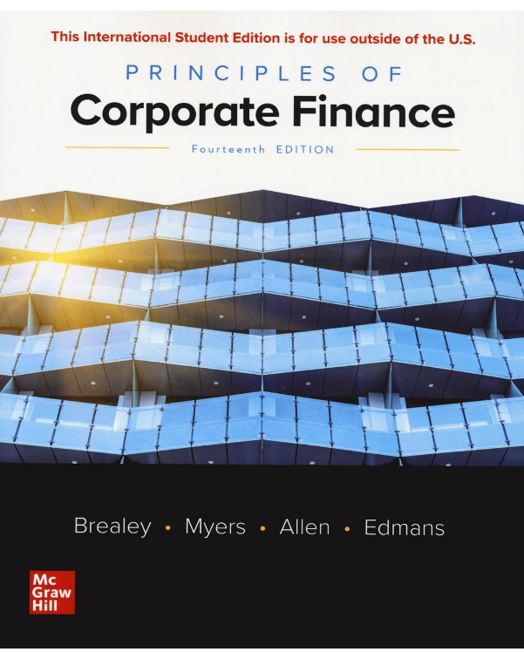
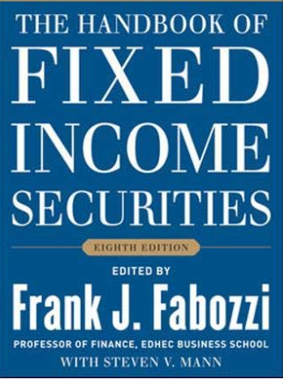
Reference from CFA Curriculum:-

Slide 23
Classes : Online
www.Lovefinance.in
www.Gardenfinance.in (Yet to be Updated )
Linked in Profile
https://www.linkedin.com/in/satish-kumar-lokavarapu-cfa-9596128/
Satish L
+91-8885643398
Satishcfa1589@Gmail.com

Slide 24
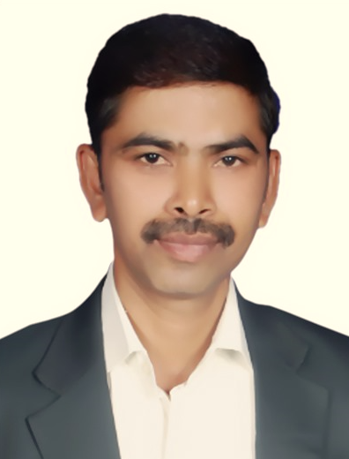
Profile
Satish Kumar L , a Qualified Charted Financial Analyst (CFA) , MBA(ADF) and BASEL Certified
16 years experience in Treasury /Capital Markets ,Investments and Risk Management (ALCO Treasury-Interest rate risk and Liquidity risk management and Market Risk )
Ex employee Riyad Bank (KSA ) ,Alrajhi Bank ,Standarad charted Bank and Wells Fargo ,Wipro ,HCL ,Hexaware Technologies and ICFAI
Working as a Management consultant , Senior manager ,Senior Business Analyst ,Financial Business Analyst and Senior consultant.
Working for Banks and various Financial institutions such as UBS ,CITI Bank ,Deutch Bank ,ADIB(Aubudhabi ) ,Thana chart BanK,SBM ,RBS through Wipro ,HCL and Hexaware .
15 Y

